Slide 1


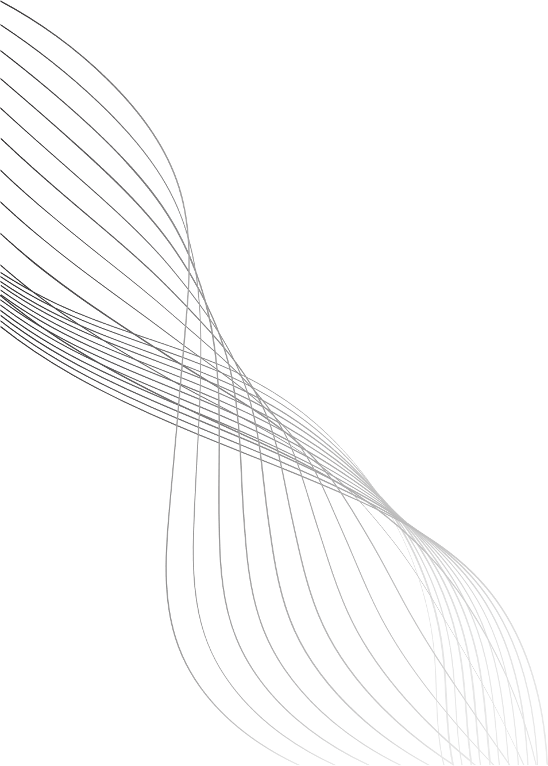
DIET RECOMMENDATION SYSTEM
By Arman Khan

Slide 2
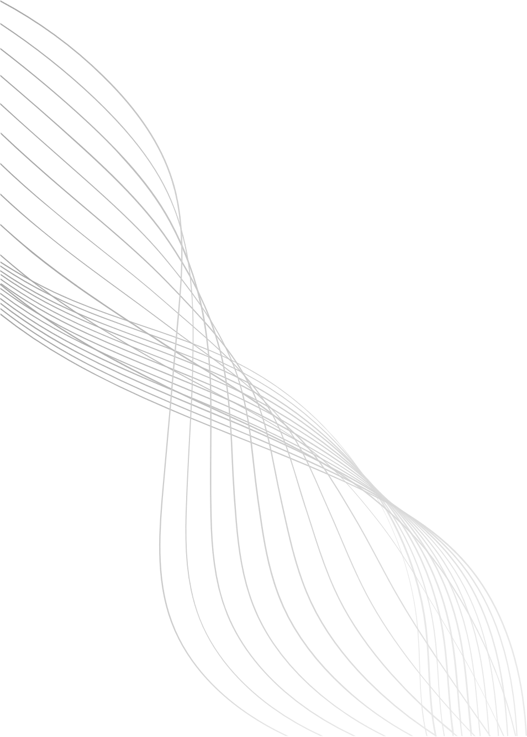
INTRODUCTION / PROBLEM STATEMENT
People find it difficult to create diet plans that truly match their body and lifestyle. Generic diets often fail because they don’t consider individual differences.
  Nutrition needs vary person to person.
  Manual calorie/macro calculation is confusing.
  One-size-fits-all diets are ineffective.
  A personalized, data-driven system is needed.
01

Slide 3
NEED FOR PERSONALIZATION
Each person has unique nutritional requirements and food preferences. Personalization ensures diets are accurate, suitable, and easier to follow.
  Depends on age, weight, height, gender.
  Activity level impacts calorie needs.
  Goals: weight loss/gain/maintenance.
  Preferences/allergies must be respected.
02

Slide 4

PROJECT AIM & OBJECTIVES
The project aims to build an AI-driven system that generates personalized meal plans using user information and food nutritional data.
  Use Deep Learning for smart recommendations.
  Automate calorie/macro calculations.
  Provide goal-based meal suggestions.
  Make diet planning simple and accurate.
03

Slide 5
SYSTEM INPUTS & WORKING PROCESS
The system collects key user details and uses them to calculate calorie needs. It then matches these needs with food data to suggest suitable meals.
Inputs:
  Age, weight, height, gender.
  Activity level and daily routine.
  Goal: lose/gain/maintain weight.
  Dietary preferences/restrictions.
Process:
  Calculate calories & macronutrients.
  Deep Learning analyzes food dataset.
  Recommend meals that meet user needs.
04

Slide 6
OUTPUT, BENEFITS & FUTURE SCOPE
The system outputs personalized meal plans that match goals and preferences. It saves time and can be expanded with more features in the future.
Outputs:
  Breakfast, lunch, dinner, snacks.
  Calorie-balanced meals.
Benefits:
  Accurate and time-saving.
  Supports healthy eating habits.
Future Scope:
  Fitness tracker integration.
  Real-time adjustments.
  Recipes and grocery lists.
05

Slide 7
SUMMARY
This project focuses on creating a personalized diet recommendation system that understands individual differences in nutritional needs. By combining user information with food nutritional data and processing it through a neural network model, the system generates tailored meal suggestions. With a simple and accessible Gradio-based web interface, users can easily receive customized diet plans without complex calculations.
06

Slide 8
THANK YOU

